Slide 1
Analysis of factors contributing to heart disease
Yiziying(Kimmi) Chen

Slide 2

Heart Disease
Also known as Coronary Artery Disease or Atherosclerosis
Leading cause of death in men and women in the US
Patients haven narrowed or blocked blood vessels
Symptoms include...
Angina
Heart attack
Stroke

Slide 3
Dataset
Source: UCI Machine Learning Repository
270 observations
13 predictors
Response variable - Disease Status (Absence or Presence)
Age (29 - 77)
Sex (183 male, 87 female) of patients
11 type of health conditions

Slide 4
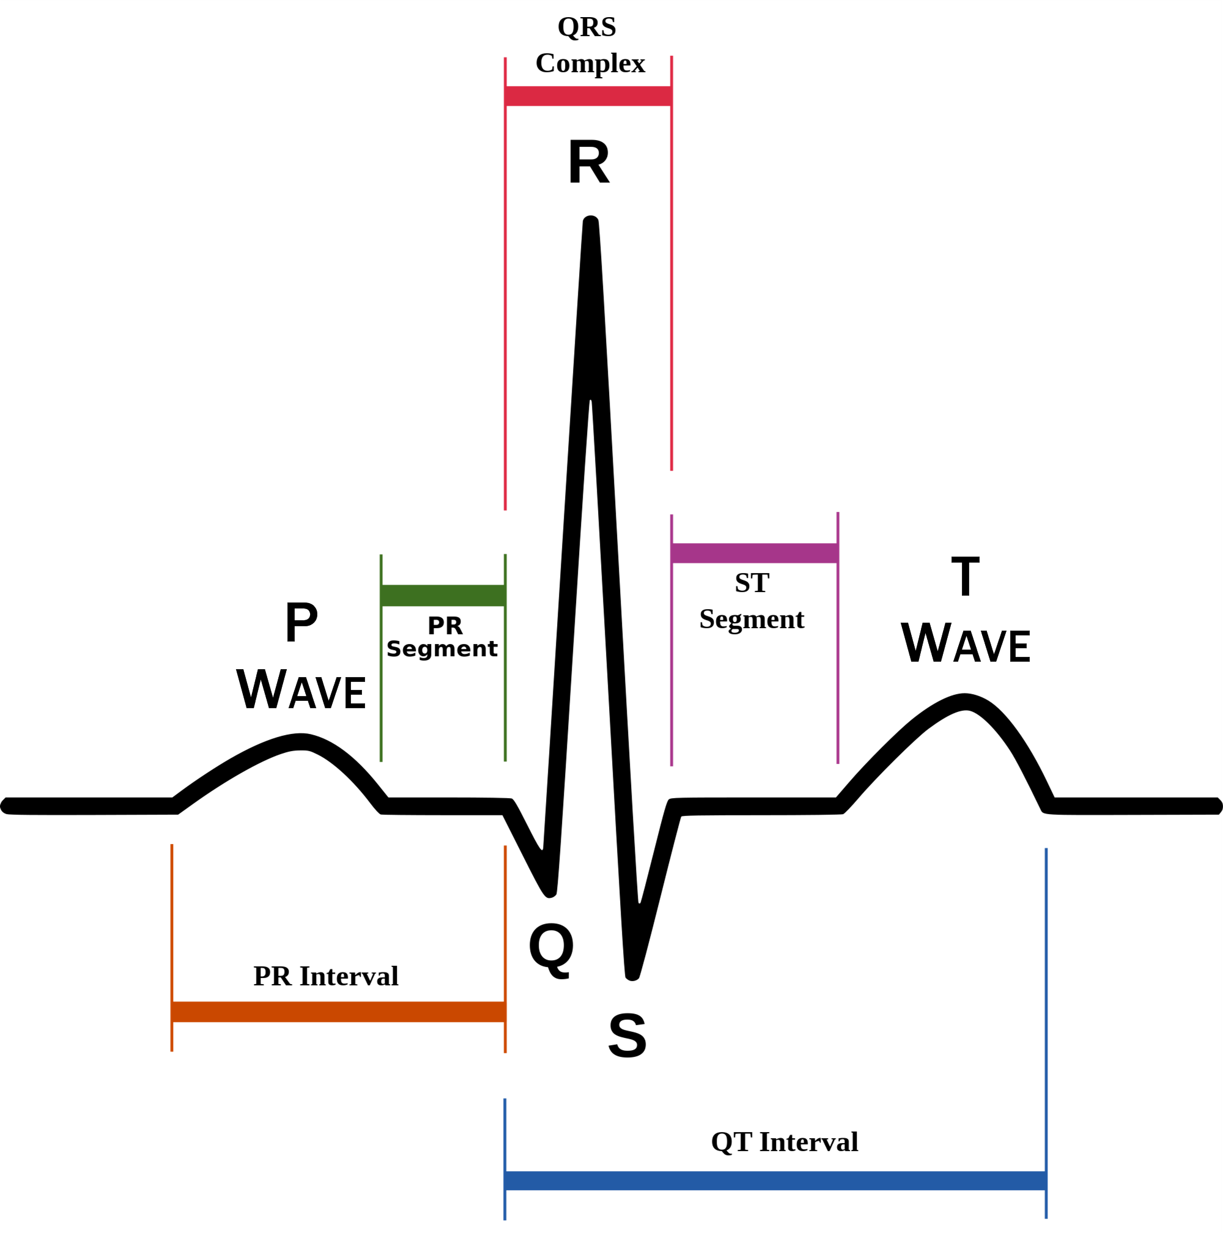
Health Conditions Measured
Chest pain (angina)
Resting blood pressure
Serum cholesterol
Fasting blood sugar
Resting electrocardiographic (EKG) results
Maximum heart rate
Exercise Induced Angina
ST depression
ST slope (at peak exercise)
Vessels colored in Angiography
Thallium heart scan

Slide 5
Methods
ANOVA
Logistic Regression
Contingency table
Generalized Linear Model
Principal Components Analysis (PCA)
Cluster Analysis
Discriminant Analysis

Slide 6
Purpose of investigating serum cholesterol level
The serum cholesterol has long been considered as a significant factor of heart disease, especially the coronary heart disease. Many researches and investigations has revealed that higher level of serum cholesterol will bring to the patient higher level of heart disease.
The question rises up to be: Is serum cholesterol suitable enough to be a substitution indicator when the presence of heart disease is not confirmed?

Slide 7
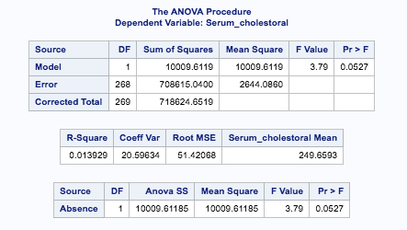
ANOVA - Serum cholesterol and Heart disease
Notes:
Although p-value is slightly larger than 0.05, they can still be regarded as significantly related.

Slide 8
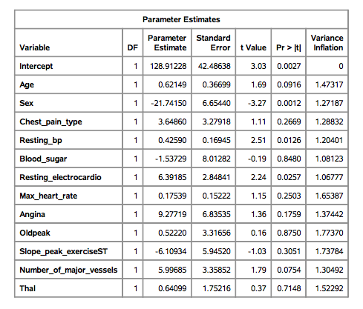
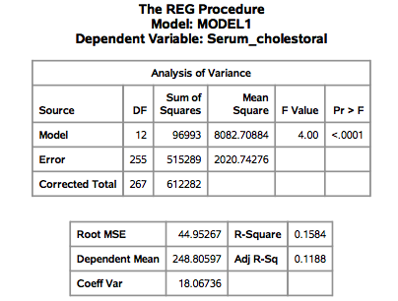
Linear regression

Slide 9
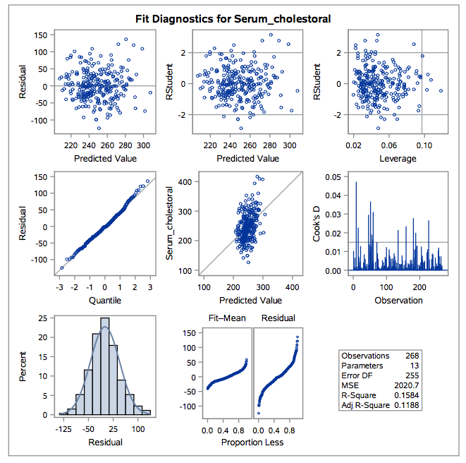
Graphs

Slide 10
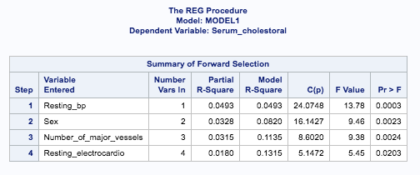
Linear regression model selection
Forward selection, sle = 0.05

Slide 11
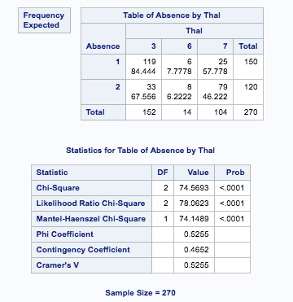
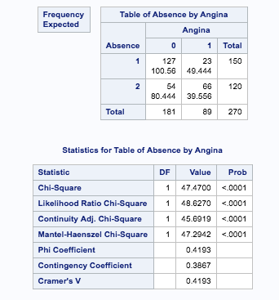
Contingency table - each indicator with heart disease

Slide 12
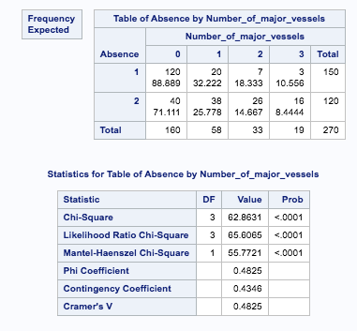
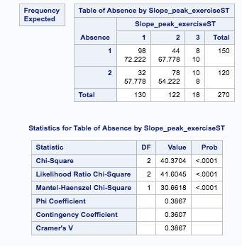
Contingency table- continued

Slide 13
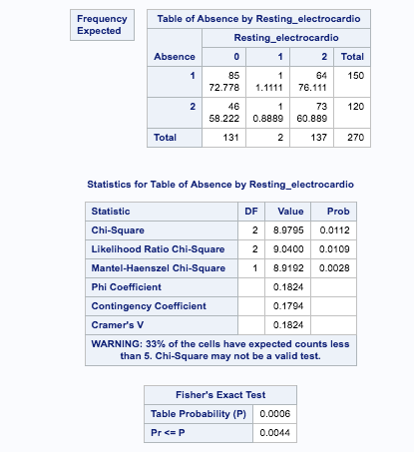
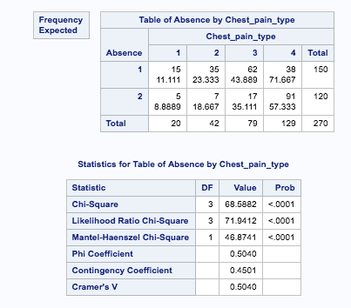
Contingency table- continued

Slide 14
Generalized Linear Analysis
Goal of the analysis:
Use generalized linear analysis to model Serum Cholesterol as a function of all the rest categorical and numeric variables as predictors and find the significant terms on model. Verify the possible assumption, Gamma distribution for the model.

Slide 15
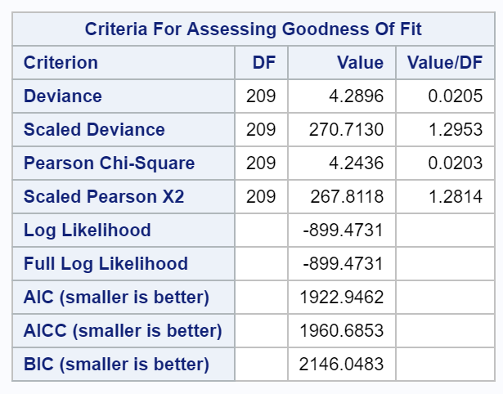
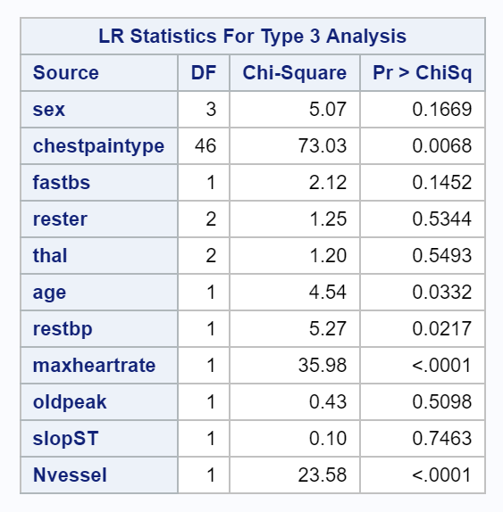
Generalized Linear Analysis-Results

Slide 16
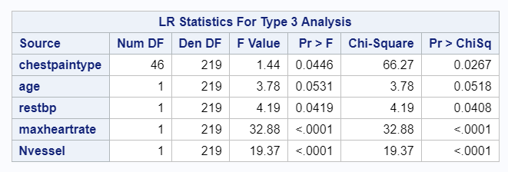
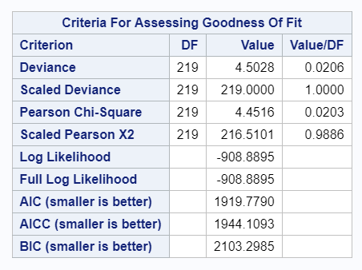
Generalized Linear Analysis
Used significant variables
Chest Pain Type (categorical)
Age
Rest blood pressure
Max Heart rate
Number of Vessels
Gamma Distribution assumption, link = log
Discard age and fit again

Slide 17
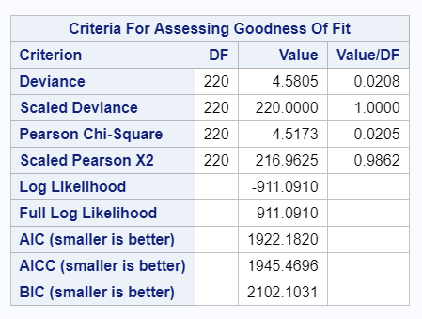
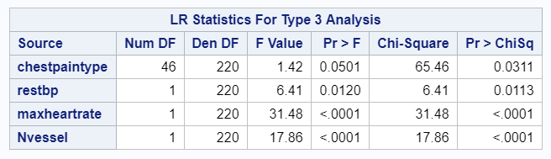
Generalized Linear Analysis-Model fitting
Used significant variables
Chest Pain Type (categorical)
Rest blood pressure
Max Heart rate
Number of Vessels
Gamma Distribution assumption
Final Model: Serum cholesterol = chest pain type + test blood pressure + max heart rate + Nvessels

Slide 18
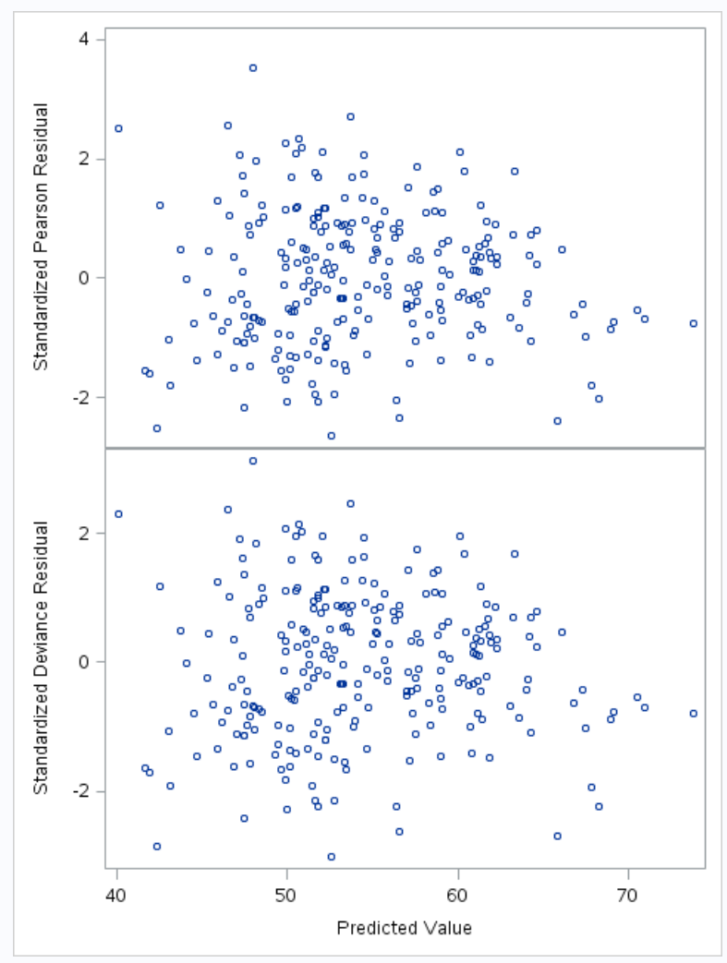
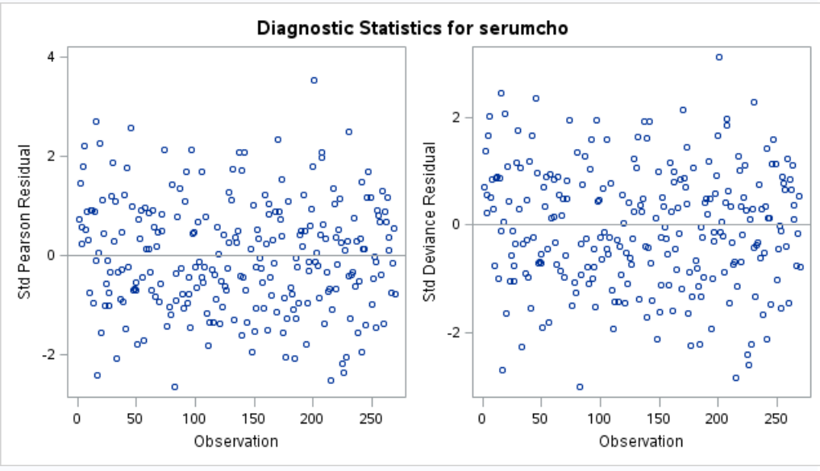
Residual plot Diagnostics-Gamma

Slide 19
Generalized Linear Analysis-Conclusion
The significant predictors to serum cholesterol are: Chest Pain Type (categorical), Resting blood pressure, Max Heart rate, Number of Vessels colored by fluoroscopy
The deviance and Pearson Chi-square values is away from 1, needs scale up.
Residual plots show flat pattern with points evenly distributed above/below zero (-2,2) which indicates that the assumption of gamma distribution of the data seems reasonable.

Slide 20
Logistic Regression
Objective:
1. Find out which factors significantly contribute to the presence of heart disease.
2. Which type of patients have higher odds of possessing heart disease.
Response: Presence(2) or Absence(1) of heart disease
Stepwise variable selections
Remove influential observations

Slide 21
Results - Logistic Regression
Significant Predictors: thal, number of major vessels, chest pain type, oldpeak, sex, the slope of the peak exercise ST segment, resting blood pressure
Type 3 Analysis of Effects
Effect | DF | Wald Chi-Square | Pr > ChiSq
Thal | 2 | 19.4501 | <0.001
Number of major vessels | 1 | 27.7682 | <0.001
Chest pain type | 3 | 28.1037 | <0.001
oldpeak | 1 | 6.3359 | 0.0118
sex | 1 | 7.7165 | 0.0055
slope | 2 | 9.4852 | 0.0087
Resting blood pressure | 1 | 4.6914 | 0.0303

Slide 22
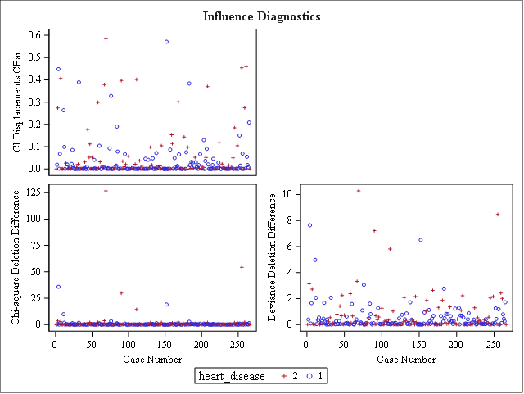

Slide 23
Odds Ratio Estimates
Effect | Point Estimate | 95% Wald Confidence Limits
Thal - fixed defect vs. normal | 0.802 | 0.161 | 3.988
Reversible defect vs. normal | 7.290 | 2.888 | 18.402
Number of major vessels | 5.432 | 2.895 | 10.195
Chest pain type - atypical vs. typical angina | 7.662 | 1.126 | 52.133
Non-anginal pain vs. typical angina | 2.599 | 0.525 | 12.876
Asymptomatic vs. typical angina | 30.214 | 5.808 | 157.179
oldpeak | 1.915 | 1.155 | 3.177
Sex - male vs female | 4.858 | 1.593 | 14.820
Slope - flat vs. upsloping | 4.996 | 1.792 | 13.926
Downsloping vs. upsloping | 2.495 | 0.346 | 18.005
Resting blood pressure | 1.027 | 1.003 | 1.052

Slide 24
Conclusions - Logistic Regression
Significant factors: thal, number of major vessels, chest pain type, oldpeak, sex, the slope of the peak exercise ST segment, resting blood pressure
Male patients with reversible defective thal, higher number of major vessels, atypical angina or asymptomatic chest pain, higher oldpeak, flat slope of the peak exercise ST segment and higher resting blood pressure have greater odds of having heart disease

Slide 25
Principal Components Analysis
Correlation check via correlation matrix
Perform principal components analysis
Interpret picked principal components
Compare the logistic regression models generated with and without PCA

Slide 26
Any Correlations?
Pearson Correlation Coefficients, N = 270 Prob > |r| under H0: Rho=0q
 | Age | Blood pressure | Cholesterol | Heartrate | Oldpeak | Vessels
Age | 1.00000 | 0.27305 <.0001 | 0.22006 0.0003 | -0.40222 <.0001 | 0.19423 0.0013 | 0.35608 <.000
Blood pressure | 0.27305 <.000 | 1.00000 | 0.17302 0.0044 | -0.03914 0.5220 | 0.22280 0.0002 | 0.08570 0.1603
Cholesterol | 0.22006 0.0003 | 0.17302 0.0044 | 1.00000 | -0.01874 0.7592 | 0.02771 0.6503 | 0.12654 0.0377
Heartrate | -0.40222 <.0001 | -0.03914 0.5220 | -0.01874 0.7592 | 1.00000 | -0.34905 <.0001 | -0.26533 <.0001
Oldpeak | 0.19423 0.0013 | 0.22280 0.0002 | 0.02771 0.6503 | -0.34905 <.0001 | 1.00000 | 0.25501 <.0001
Vessels | 0.35608 <.0001 | 0.08570 0.1603 | 0.12654 0.0377 | -0.26533 <.0001 | 0.25501 <.0001 | 1.00000

Slide 27
How Many Principal Components?
Eigenvalues of the Correlation Matrix
 | Eigenvalue | Difference | Proportion | Proportion
1 | 2.06850480 | 0.95057274 | 0.3448 | 0.3448
2 | 1.11793207 | 0.19543005 | 0.1863 | 0.5311
3 | 0.92250202 | 0.19027505 | 0.1538 | 0.6848
4 | 0.73222697 | 0.01651841 | 0.1220 | 0.8069
5 | 0.71570856 | 0.27258297 | 0.1193 | 0.9261
6 | 0.44312559 |  | 0.0739 | 1.0000

Slide 28
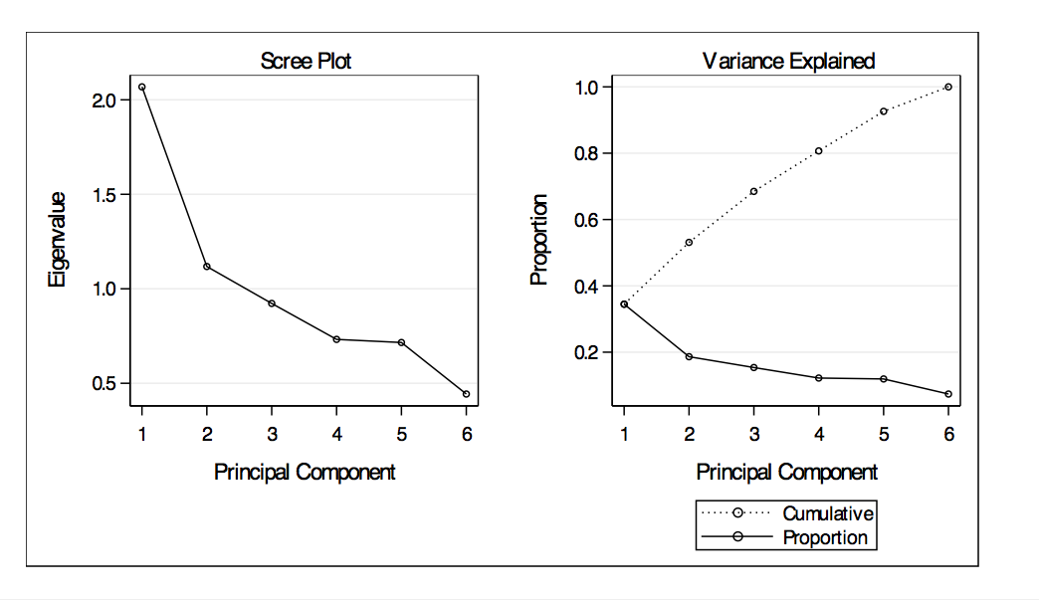
How Many Principal Components? - Continued

Slide 29
2 Principal Components
Eigenvectors
 | Prin1 | Prin2 | Prin3 | Prin4 | Prin5 | Prin6
age | 0.521612 | 0.111958 | -.217613 | -.511268 | 0.170384 | 0.614496
bloodpressure | 0.309932 | 0.503218 | 0.644869 | -.179998 | 0.278525 | -.353387
cholesterol | 0.228614 | 0.675829 | -.383077 | 0.277921 | -.510480 | -.080074
heartrate | -.458097 | 0.433557 | 0.106201 | 0.367251 | 0.404228 | 0.540946
oldpeak | 0.419966 | -.269654 | 0.497748 | 0.502576 | -.328123 | 0.378041
vessels | 0.439743 | -.129642 | -.361952 | 0.491437 | 0.601446 | -.235717

Slide 30
Features Picked out from PCs
PC1: the problem of aging
age, oldpeak, vessels (+), and maximum heart rate achieved(-)
PC2: Important personal health numbers
serum cholesterol, blood pressure, and maximum heart rate achieved (+)
￼
￼

Slide 31
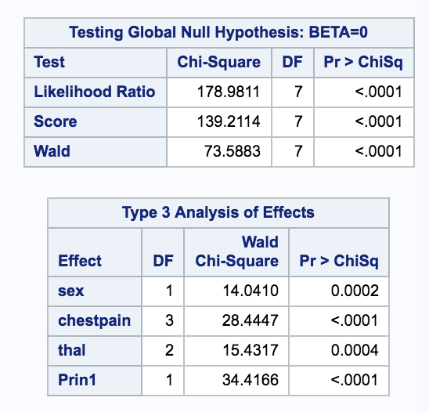
Logistic Regression Model Fitted with PC1 and PC2 and other variables

Slide 32
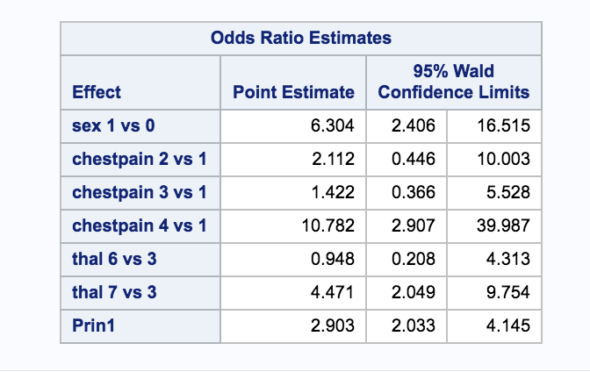
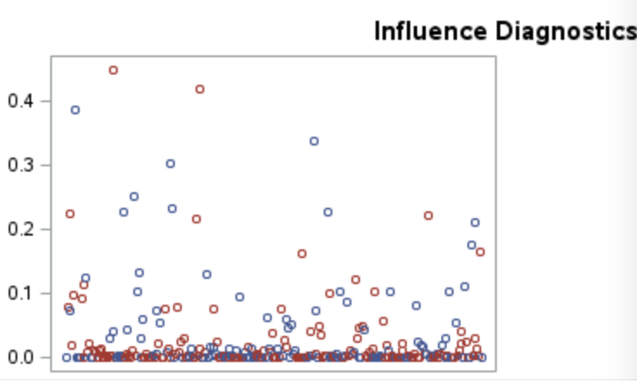
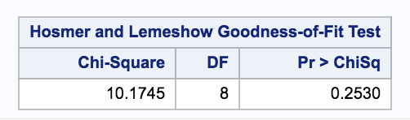
Logistic Regression Model Fitted with PC1 and PC2 and other variables

Slide 33
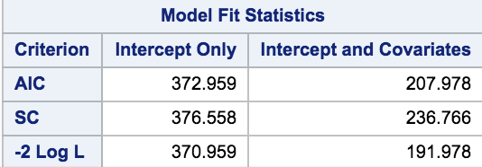
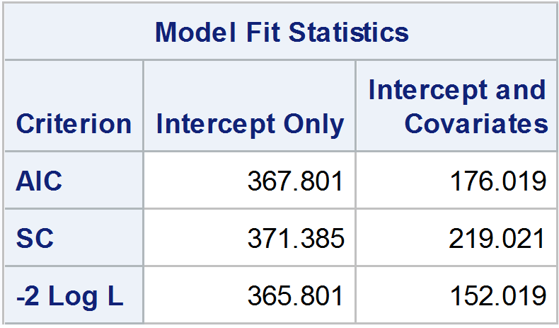
Logistic regression model generated with PCA V.S without PCA
PCA
Without PCA
Significant factors: sex, chest pain type, thal, PC1 (the problem of aging: age, oldpeak, number of major vessels, and maximum heart rate achieved)
Significant factors: thal, number of major vessels, chest pain type, oldpeak, sex, the slope of the peak exercise ST segment, resting blood pressure

Slide 34
Results - Cluster Analysis
Used all continuous variables
Age
Blood Pressure
Cholesterol
Heart Rate
Both ST measures
Blood vessels colored
Complete, single, and average linkages
Original and Standardized
RESULT - Observations seems to be unclustered

Slide 35
Complete Linkage (Standardized)
Cluster History
Number of Clusters | Clusters Joined |  | Freq | Semipartial R-Square | R-Square | Approximate Expected R-Square | Cubic Clustering Criterion | Pseudo F Statistic | Pseudo t-Squared | Norm Maximum Distance | Tie
5 | CL8 | CL16 | 17 | 0.0182 | .315 | .475 | -15 | 30.4 | 5.5 | 1.8556
4 | CL7 | CL12 | 180 | 0.0521 | .263 | .431 | -14 | 31.6 | 22.2 | 1.9413
3 | CL6 | CL4 | 248 | 0.1440 | .119 | .364 | -18 | 18.0 | 53.7 | 2.1581
2 | CL3 | CL5 | 265 | 0.0847 | .034 | .258 | -16 | 9.4 | 25.6 | 2.4043
1 | CL2 | CL14 | 270 | 0.0340 | .000 | .000 | 0.00 | . | 9.4 | 2.7569

Slide 36
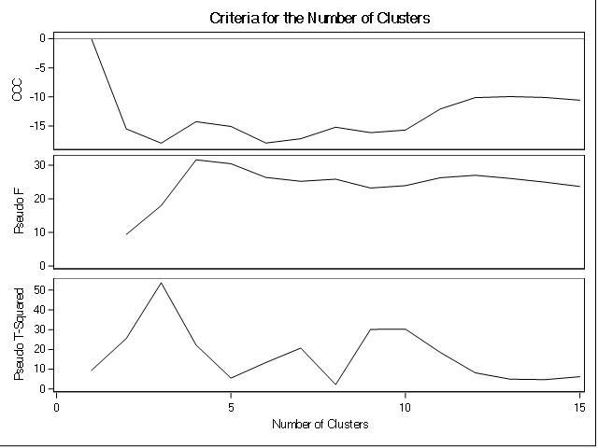
Complete Linkage (Standardized)

Slide 37
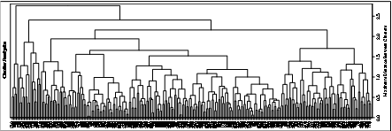
Dendrogram

Slide 38
Discriminant Analysis
Goal of the analysis:
Use MANOVA to check whether classification of the heart disease groups (presence/absence) would be meaningful.
Homogeneity test whether use LDA or QDA.
Use stepwise model selection to pick up significant predictors in the model using presence/absence of heart disease as the response value.
Use Resubstitution and Cross Validation to check misclassification rate.

Slide 39
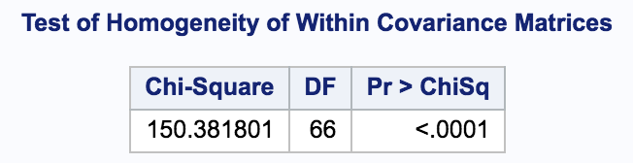
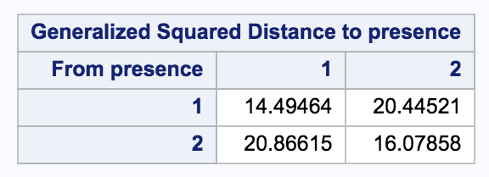
Homogeneity test-full model
Homogeneity test gives a p-value <0.05, so we reject the null hypothesis and use QDA.

Slide 40
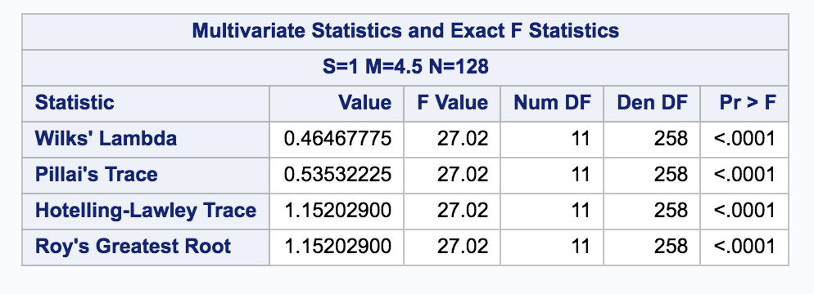
MANOVA test-full model
Results: a p-value<0.05 tells us to reject the null hypothesis and we conclude it would be meaningful to make classification on the presence/absence of heart disease groups.

Slide 41
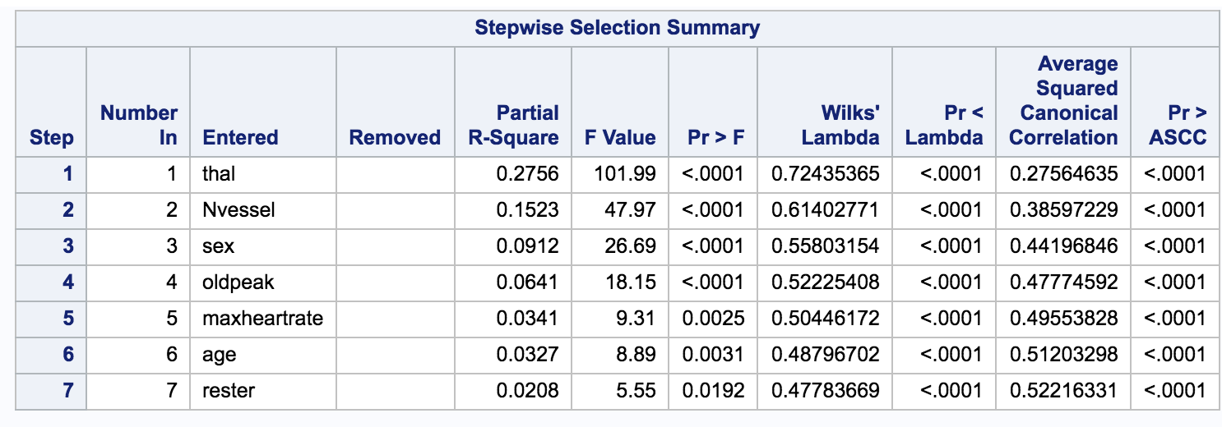
Model selection
Using presence/absence of heart disease as response.

Slide 42
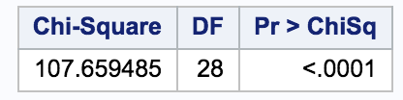
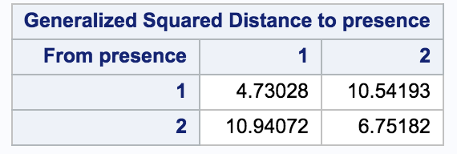
Homogeneity test-refined model
Test of Homogeneity within Covariance Matrix
Result: the p-value from the test is <0.05, so we reject the null hypothesis and choose to use QDA.

Slide 43
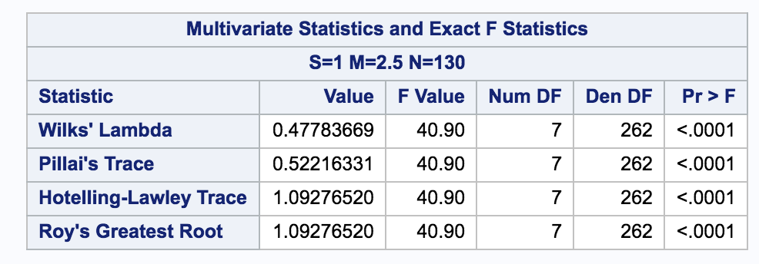
MANOVA test on refined model
Results: a p-value<0.05 tells us to reject the null hypothesis and we conclude it would be meaningful to make classification on the presence/absence of heart disease groups.

Slide 44
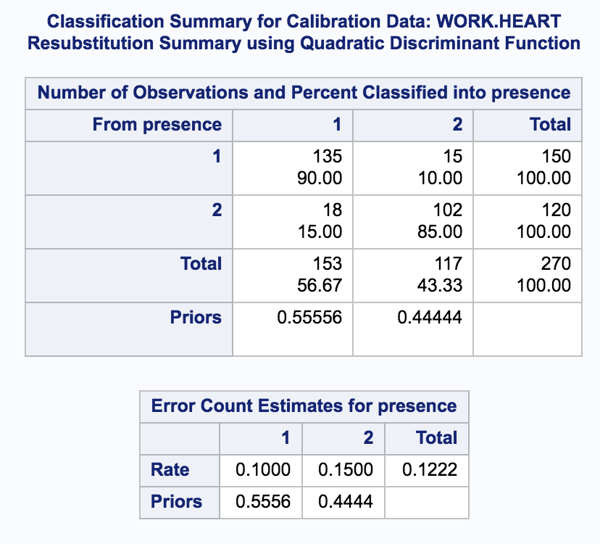
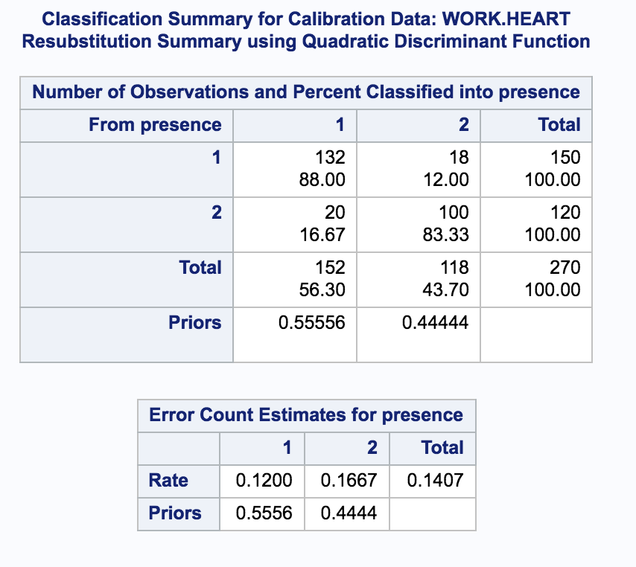
Resubstitution Misclassification rate
Full Model error rate
Refined Model error rate

Slide 45
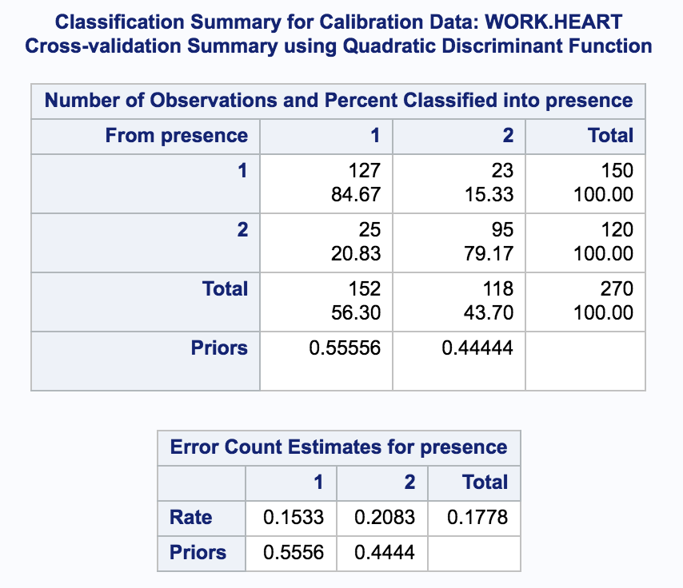
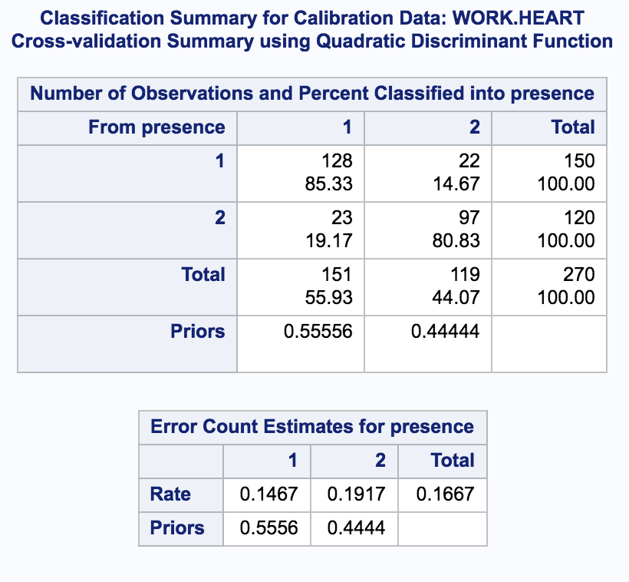
Cross validation Misclassification rate
Full Model error rate
Refined Model error rate

Slide 46
Discriminant Analysis-Conclusion
Homogeneity tests tell us to use QDA procedure.
Stepwise model selection gives a refined model with significant predictors: thal, number of Vessels colored by fluoroscopy, sex, age , max heart rate, old peak, rest electrocardiographic results; response variable: presence/absence of heart disease.
MANOVA tests tell us the presence/absence of heart disease has different group means and classification seems to be meaningful.
The refined model gives a lower cross-validation total error rate compared to the full model. The misclassification rate is higher in the ‘presence of heart disease’ group than in the ‘absence of heart disease’ group.

